Slide 1
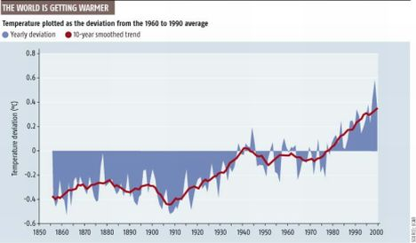




Talking Global Change with the Public and the Media
Clarisse Hart
Harvard Forest Outreach
& Education Manager

Slide 2
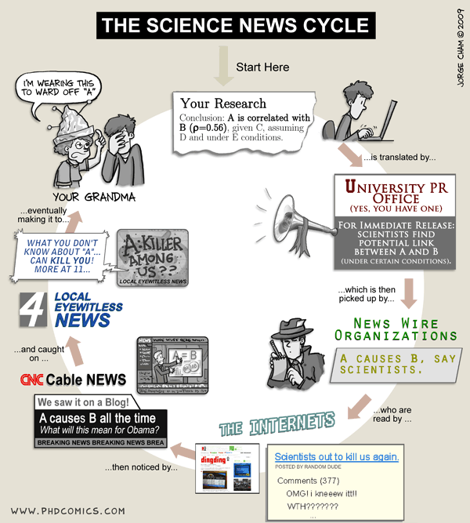

Slide 3
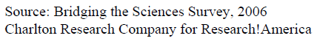
Pop quiz! Question 1
According to a 2006 survey, what percentage of Americans say scientists are people of “very great” or “considerable” prestige?
a) 24 %
b) 46 %
c) 63 %
d) 87 %
The highest of any job category
included in the survey.

Slide 4
Pop quiz! Question 2
What percentage of Massachusetts residents are able to name a nearby institution engaged in research?
a) 20 %
b) 40 %
c) 60 %
d) 80 %
And only 26% of them are able
to name a living scientist.
While 85% of the members of the American Association for the Advancement of Science say public ignorance of science is a “major problem,” only 3% of those scientists say they “often” speak to the media.
Notes:
-environment writer Eugene Linden

Slide 5
Barriers to getting good scientific information to the public
Decline of space and staff for science reporting
Proliferation of dubiously rigorous blogs and online news sources
The problem of objectivity
  “Fair and balanced” reporting can lead to an overweighting of dissent
Lack of public interest?
Notes:
The National Resource Council surveyed high school biology students at the beginning and end of the 10th grade, and found they were less interested in science at the end of the year than at the beginning.

Slide 6

Economist readers speak out:
10 most important news events since 1850
The vast change in the status of women
Freud and the development of psychoanalysis
Darwin’s theory of evolution
The development of communism
Fascism and the rise of totalitarian dictatorships
The invention of the automobile
Electricity and its offshoots (light, telegraph to television, movies)
The end of slavery on the basis of color
The end of monarchy as a form of government
The conquest of space

Slide 7
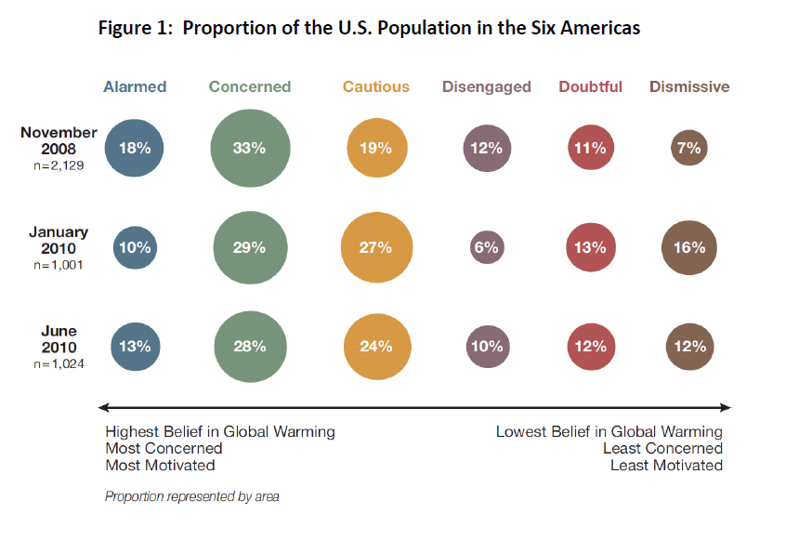
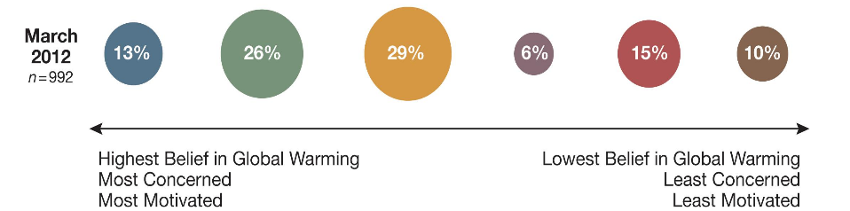
Beliefs and Attitudes
Six Americas, March 2012 and Nov. 2011
Notes:
The average number of climate science facts known by people at both ends of the spectrum is, on average, the same.

Slide 8

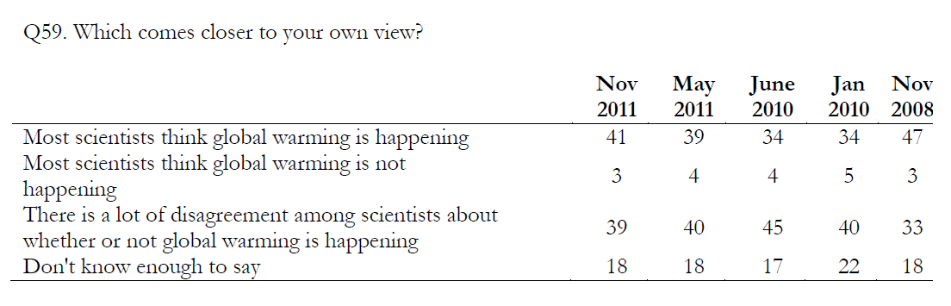
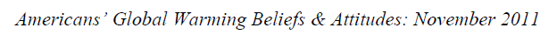
Beliefs and Attitudes

Slide 9
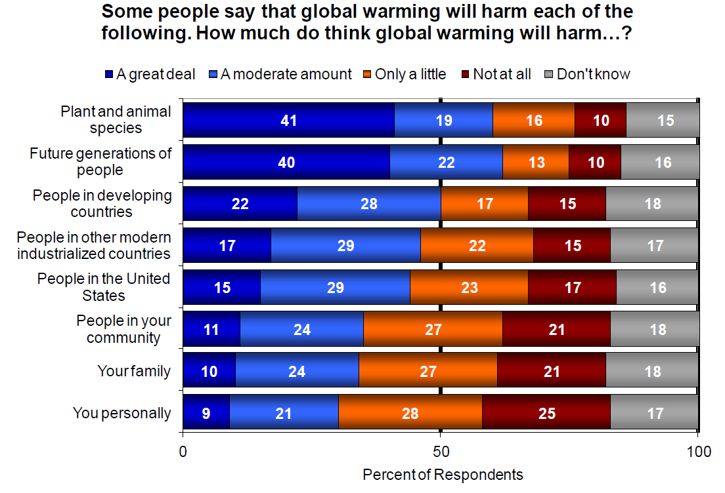
What do we know, and how do we know it?
Notes:
Populations most impacted seem to be a theoretical “other,” while more personal impacts don’t seem to be on people’s radar.

Slide 10
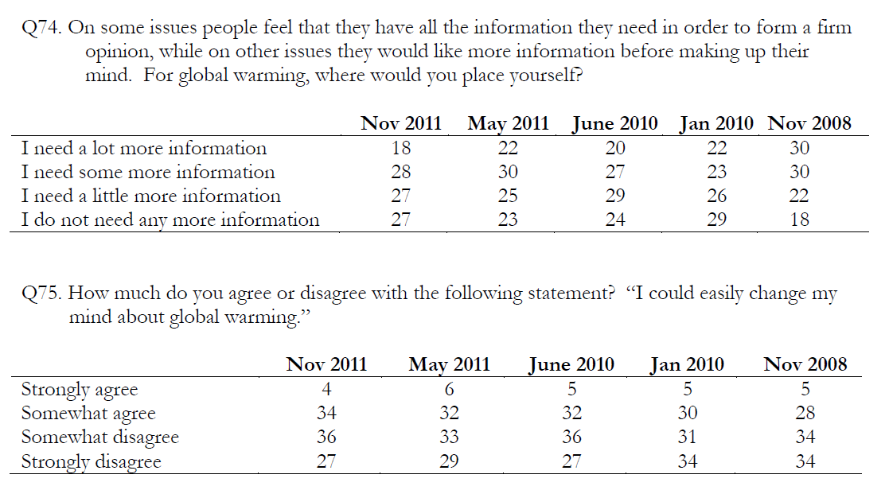
What do we know, and how do we know it?

Slide 11
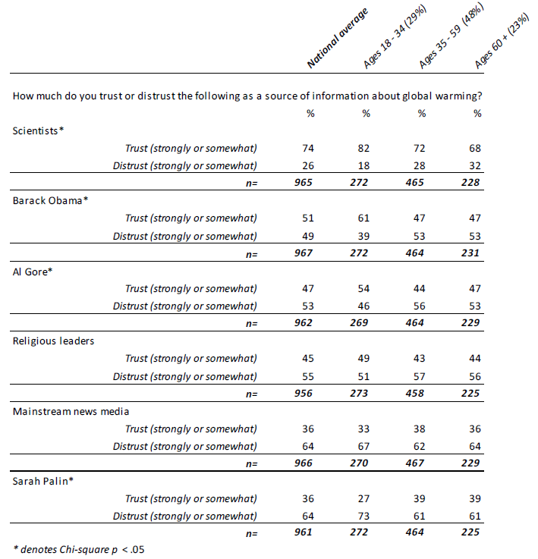

Notes:
The mainstream news media and Sarah Palin were about equal in terms of public trust about information on global warming.

Slide 12

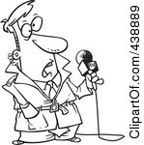
Apples and Oranges?
The public may see scientists as
Scientists may see the public as
Boring
Hair-splitting
Caveating things to death
Unable to articulate a bottom line
Unintelligibly
jargon-y speakers
Unconcerned with accuracy
Superficial
Sensationalist
Focused on controversy
Ignorant

Slide 13
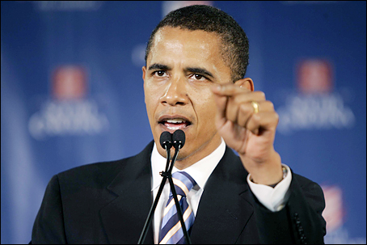
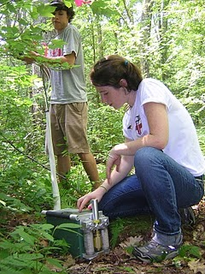

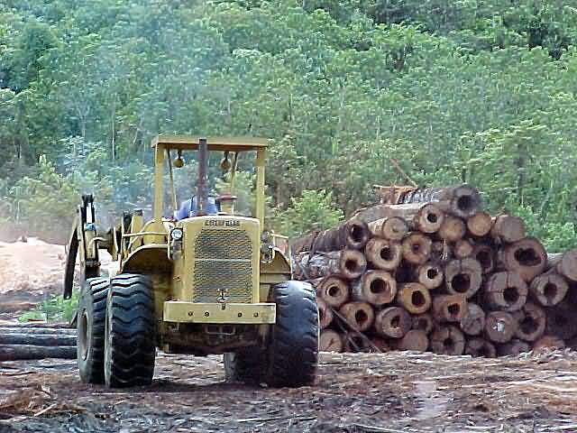

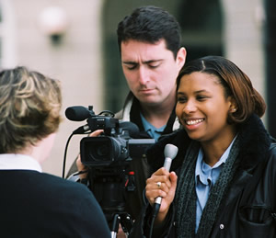
Consider Your Audience

Slide 14
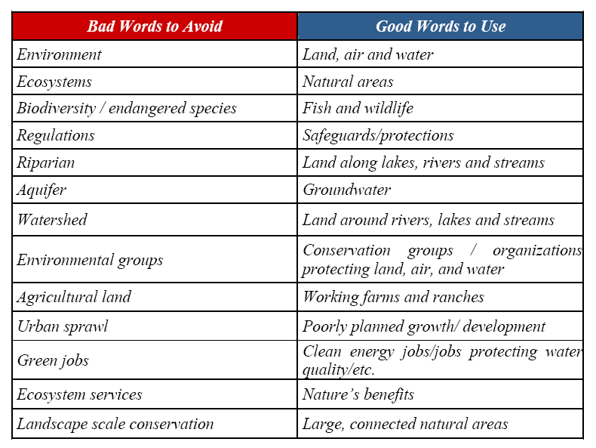
Talking to policymakers:
What makes voters vote?
“The Language of Conservation”: The Nature Conservancy and The Trust for Public Land, 2004

Slide 15

Talking to the media:
What makes news news?
Extent (broad impact)
Intensity (deeply felt)
Consequence (major repercussions)
Novelty
Eminence or celebrity
Proximity (local angle)
Timeliness (first scoops)
Currency

Slide 16
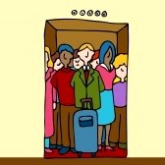
Tell a Story
ASSIGNMENT 1: Elevator Speech
Answer: what, who, why, when, where, how?
  What methods or equipment are you using?
  What environments are you working in?
Avoid jargon, acronyms, and abbreviations.
Mention small- and large-scale implications.
ACTIVITY: Check out the examples below; discuss what works and what doesn’t – then try it out yourself!
Susan Barry, neurobiologist
Alan Sage, plant physiologist
Katharine Hayhoe, climate scientist
Shaundra Daily, computer scientist
Michio Kaku, theoretical physicist
Mireya Mayor, primatologist
Emily Whiting, architectural engineer
Andre Fenton, neurobiologist
Dave Sulzer, neuroscientist
Caryn Babaian, high school teacher
Allan Adams, theoretical physicist

Slide 17
Tell a Story
ASSIGNMENT 2: Blogging!
Write a 400 to 600-word blog about your research project. Group project profiles should be co-written and can range up to 800 words.
ALTERNATIVE ASSIGNMENT: Pairs of students write blogs about each other’s projects.
You’ll submit your text & photos to the proctors according to a set blog schedule.
http://HarvardForestREU.blogspot.com

Slide 18
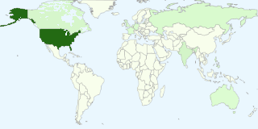
The Basics of Science Blogging
Begin where your readers are.
What do they already know?
Why should they care?
Assume you only have the title & first couple of lines (the lede) to get your readers’ attention.
Early on:
  Tell them something they didn’t know.
  Avoid jargon!
  Give them something visual to grab on to – both descriptively and with photos.
search: Harvard Forest REU

Slide 19
Writing a Good Lede: Activity
See examples in hand-out.
Watch The Island President trailer – a different way to think about packaging a climate change message.

Slide 20
Writing a Good Lede
Example 1 from the HF REU blog
PROJECT PROFILE: Tracking Moose and Deer
We have spent the summer happily crawling around in the forest, bruising ourselves under mountain laurel in pursuit of the holy grail of our project, moose poop. We are studying the impact of deer and moose browsing on the regeneration of forests, specifically looking at hemlock and oak seedlings. This research is particularly important since the number of white tailed deer continues to increase, and moose recently reappeared in Massachusetts after being extirpated since the mid-19th century.

Slide 21
Writing a Good Lede
Example 2 from the HF REU blog
PROJECT PROFILE: Soil Warming and Hardwoods
Here at the Harvard Forest, I am working on the effects of soil warming on various hardwoods. There has already been an experiment to test the effects of global warming on soil. The 20-year-long experiment found that with increased soil temperatures there was an increase in microbial activity. This increase in microbial activity led to more usable nitrogen in the system.

Slide 22
Writing a Good Lede
Example 3 from the HF REU blog
RESEARCH PROFILE: Vegetation Sampling in Wildlands and Woodlands
We have spent most of the summer traveling across New England to do field work at sites in Massachusetts, New Hampshire, and Maine. At each site, we have been establishing permanent vegetation sampling plots for a long-term study comparing forest dynamics in managed and unmanaged forests. We carry 2-foot pieces of steel pipe into the woods (3 lbs per pipe x 3 plots x 4 pipes per plot + 10 lbs for other gear = Wicked heavy), use them to mark the corners of 20x20 meter plots, and survey these plots for herb-layer species, saplings, trees, evidence of historical disturbance, and environmental variables.

Slide 23
Writing a Good Lede
Example 4 from the HF REU blog
PROJECT PROFILE: Pitcher Plant Communities as Model Food Webs
Covered in mud, and smelling similar to the stagnant swamp I found myself surrounded by, I peer deep into the small cuplike leaves of the Sarracenia purpurea (Northern Pitcher Plant), a long-lived carnivorous plant. Contained in these delicate green and red veined pitchers (which have become my life for this summer) an entire detritus-based food-web thrives. This community, consisting of bacteria, protozoa, rotifers, and anthropods, is diversified with numerous endemic species that can only be found within this unique little niche.

Slide 24
Media Messaging
“The hardest thing for me to remember when talking to a reporter is to go in with three main points and then not ramble around/go off point. It really dilutes the message and you also get crazy quotes attributed to you!”
~A Harvard Forest researcher

Slide 25
Media Messaging
A cautionary tale
New England Maple Trees Under Asian Longhorned Beetle Attack. The Post Chronicle.
Threat from Asian beetle expands beyond cities. The Boston Globe.
Are New England's Iconic Maples at Risk? The National Science Foundation.
Trees Showing Resilience to Beetles. Worcester Telegram & Gazette.
Editorial - Holding ground: Beetle vs. tree goes to OT. Worcester Telegram and Gazette.
Notes:
Headlines from an August 2011 Harvard Forest press release (and subsequent scientist interviews). Which of these don’t belong?
The T&G later posted an editorial reasserting that the ALB is, still, in fact a threat.

Slide 26
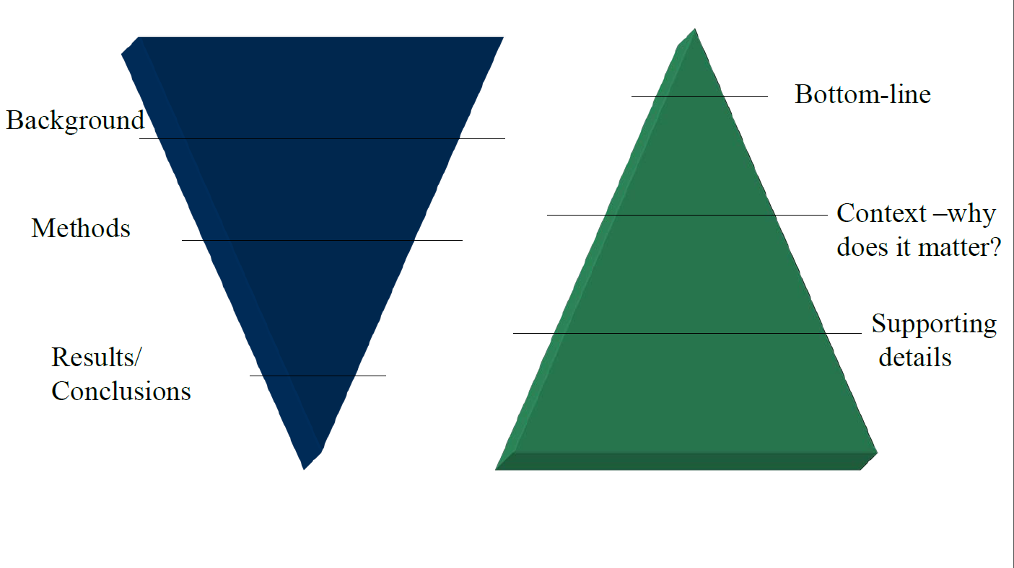
Flip the Science Communication Triangle
Scientific Papers
Public Communication

Slide 27
Media Messaging
Activity
Read your scientific paper.
Pick 3 main story points you’d include in a blog or news article.
Draft a headline and lede.
Who would you get quotes from?
Envision a photo or piece of media to accompany the text.

Slide 28
Writing a Good Lede
Examples from HF Press Releases
Every time you go outdoors in New England, you’re surrounded by at least a dozen species of ants. Some are pavement or picnic specialists; others live under rocks, inside acorn caps, or in the branches of trees. (press page)
When we imagine drama playing out between predators and prey, most of us picture stealthy lions and restless gazelle, or a sharp-taloned hawk latched on to an unlucky squirrel. But Ben Baiser, a post-doctoral fellow at the Harvard Forest and lead author of a new study in Oikos, thinks on a more local scale. His inter-species drama plays out in the humble bogs and fens of eastern North America, home to the carnivorous pitcher plant, Sarracenia purpurea. (press page)
In newscasts following intense wind and ice storms, damaged trees stand out: snapped limbs, uprooted trunks, sometimes entire forests blown nearly flat. In the storm’s wake, landowners, municipalities, and state agencies are faced with important financial and environmental decisions. A new study by Harvard University researchers, soon to be published in the journal Ecology, yields a surprising result for large woodlands: When it comes to the health of forests, native plants, and wildlife, the best management decision may be to do nothing. (press page)
ACTIVITY: Find some strong examples in newspapers & magazines provided.

Slide 29
Media Messaging
Activity
Watch the evolution from scientific paper title to headline.
Track the dates on the publications.
How are the ledes?
What story points were chosen?
Who was interviewed?
Note the photo(s) used.

